Slide 1
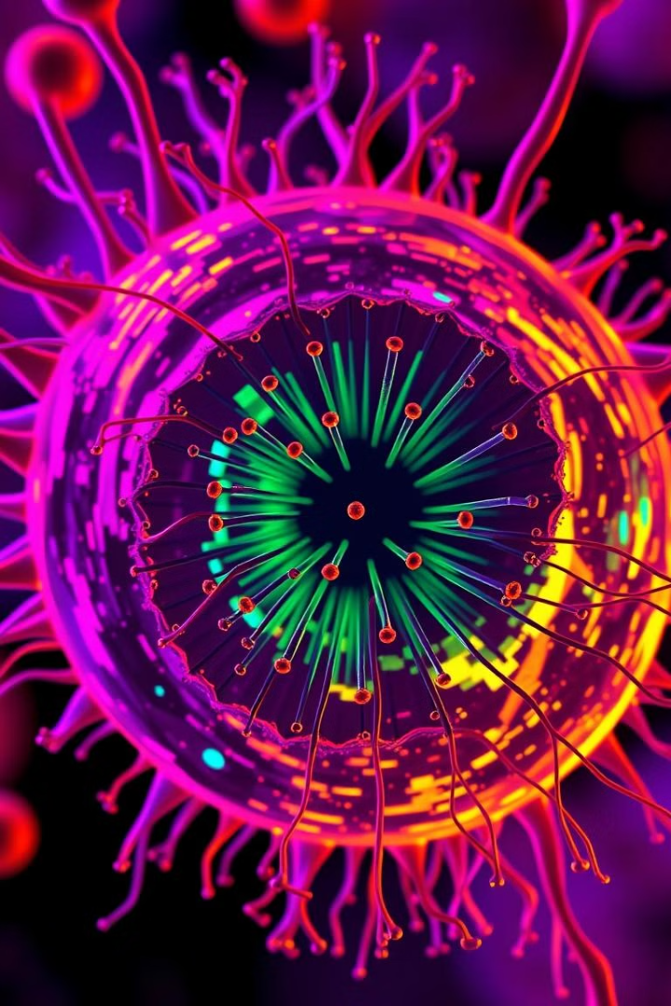
Centrioles: The Powerhouses of Cell Division
Centrioles are small, cylindrical organelles found in animal cells that play a crucial role in cell division. They are essential for the organization of microtubules, which form the mitotic spindle, the structure responsible for separating chromosomes during cell division.

Slide 2
What are Centrioles?
Tiny Organelles
Essential for Division
Centrioles are small, cylindrical organelles found in pairs, typically near the nucleus of animal cells.
They play a crucial role in cell division by organizing microtubules, which form the mitotic spindle.

Slide 3
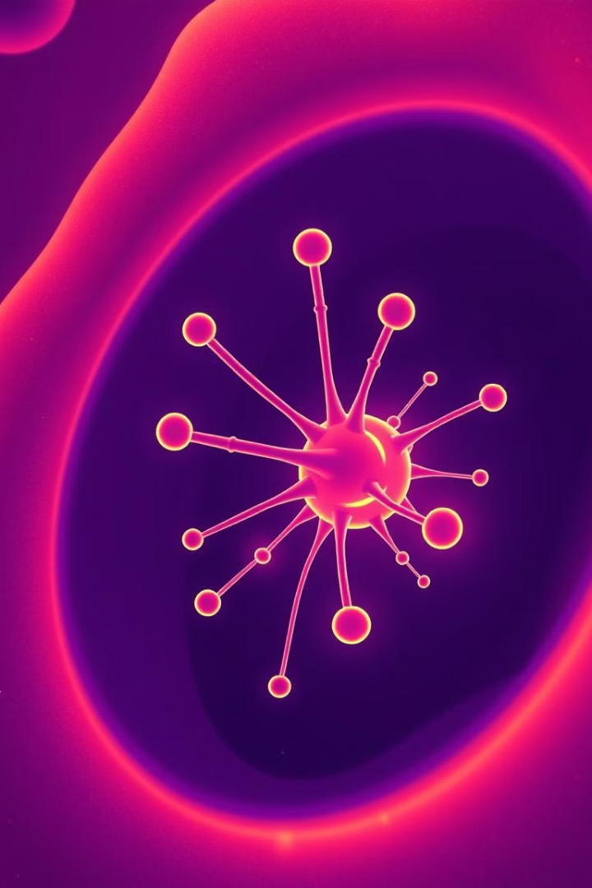
Structure and Components of Centrioles
1
Nine Microtubule Triplets
2
Connecting Proteins
The microtubule triplets are connected by proteins, ensuring structural integrity and stability.
Centrioles are composed of nine microtubule triplets arranged in a circular pattern.
3
Centriolar Satellites
Small, protein-rich structures associated with centrioles, involved in microtubule organization and regulation.

Slide 4
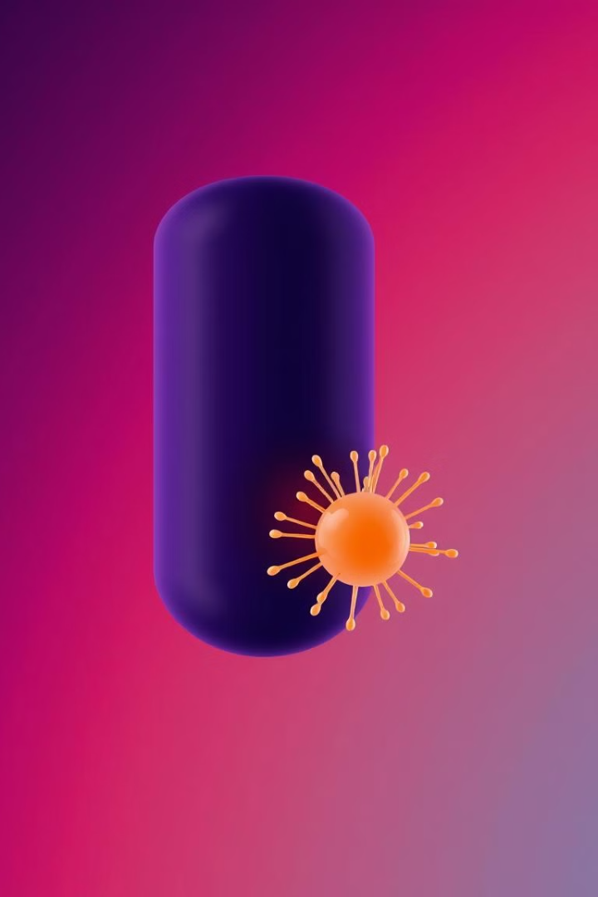
Centriole Duplication and Maturation
1
Centrioles replicate during the S phase of the cell cycle, ensuring that each daughter cell inherits a pair.
2
The new centrioles assemble near the pre-existing ones, forming a pair of centrioles perpendicular to each other.
3
The newly formed centrioles mature over time, developing their full structure and function.

Slide 5
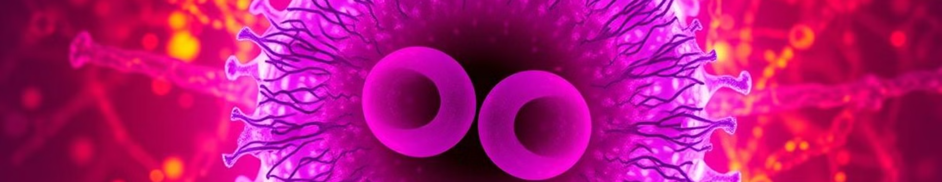


Role of Centrioles in Centrosome Formation
Centrosome Structure
Pericentriolar Material
Centrioles are essential for the formation of centrosomes, the microtubule organizing centers of animal cells.
Centrioles are embedded in a protein-rich matrix called pericentriolar material, which is critical for microtubule nucleation and organization.

Slide 6
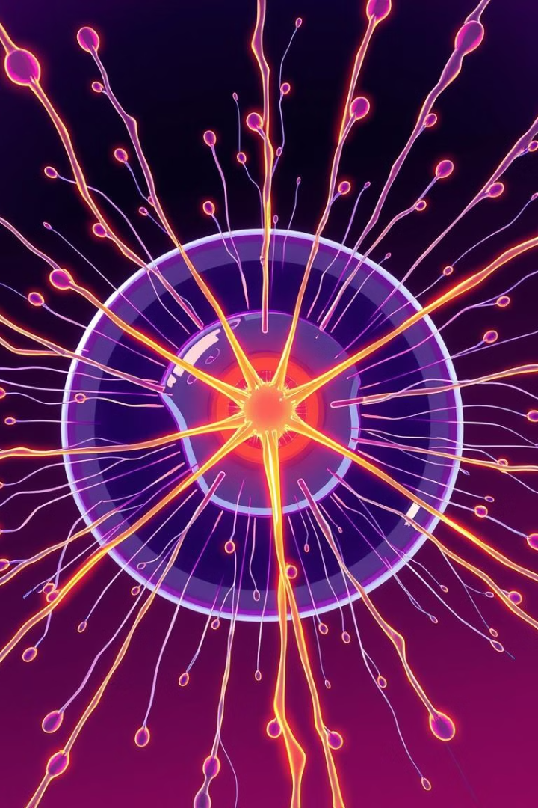



Centrioles and Microtubule Organization
Microtubule Organizing Centers
Centrioles are the microtubule organizing centers (MTOCs) of animal cells.
Mitotic Spindle Formation
Centrioles are responsible for organizing microtubules, which form the mitotic spindle, the structure that separates chromosomes during cell division.
Cilia and Flagella Formation
In some cells, centrioles are involved in the formation of cilia and flagella, hair-like structures that aid in movement and sensing.

Slide 7



The Importance of Centrioles in Cell Division
Accurate Chromosome Separation
1
Centrioles play a vital role in ensuring that chromosomes are accurately separated during cell division.
Proper Cell Cycle Progression
2
Centrioles help regulate the progression of the cell cycle, ensuring that cells divide correctly.
Genetic Stability
3
By ensuring accurate chromosome separation, centrioles contribute to the genetic stability of organisms.

Slide 8
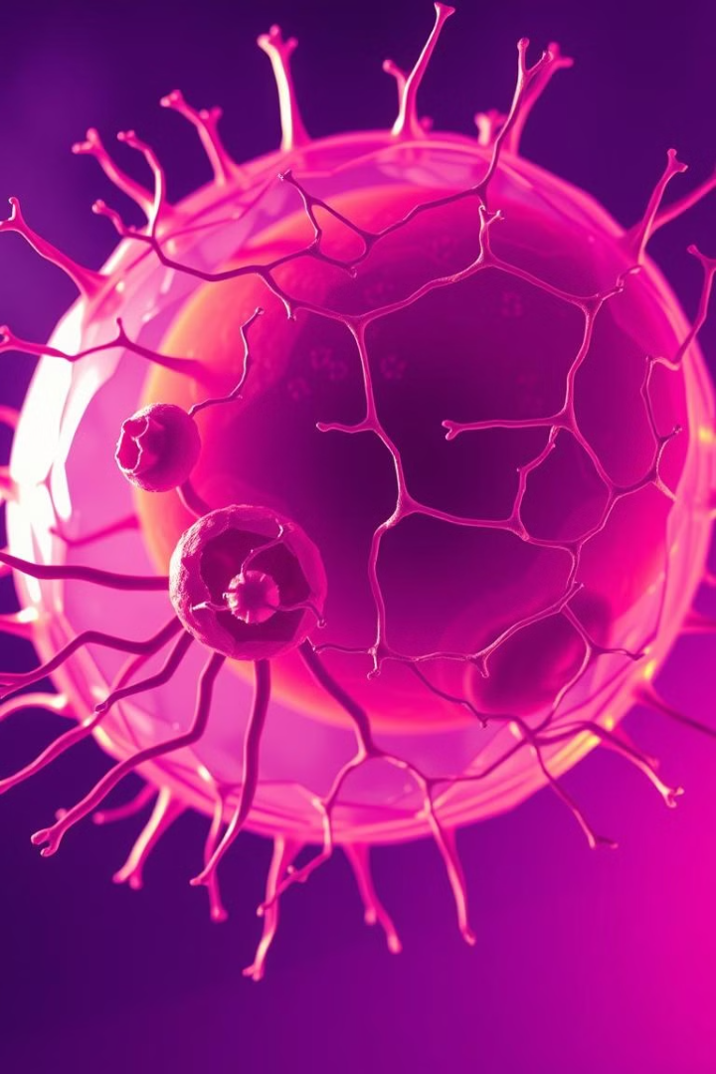
Centriole Abnormalities and Disease Implications
1
2
Centriole Number
Centriole Structure
Abnormal numbers of centrioles can disrupt cell division and lead to genetic instability.
Defects in centriole structure can impair microtubule organization and affect cell division.
3
Disease Implications
Centriole abnormalities have been linked to various diseases, including cancer and developmental disorders.

